Slide 1
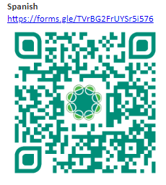
EPHS Teacher & Student Needs Survey

Slide 2
David’s Law
Bullying Prevention
EPHS Counseling Team

Slide 3
SB 179 - David's Law
Relating to harassment, bullying, and cyberbullying of a public school student or minor and encouraging certain mental health programs for public school students; increasing a criminal penalty, providing a civil remedy.

Slide 4
David's Law
Law amends the Education Code provisions regarding bullying to better define and encompass cyberbullying.
It provides for anonymous reporting for students, includes cyberbullying off campus and after school hours, and modifies the parental/guardian notification procedure.
It expands the scope of instruction that can satisfy continuing education requirements for classroom teachers and principals to include instruction related to grief-informed and trauma-informed strategies.

Slide 5
Major Points
Effective September 1st 2017
Bullying is no longer defined as “recurring acts.” If the one act is intended to cause harm or encourages a student to commit suicide, the student who prompted it may be in violation of David’s Law .
Cyberbullying is a big part of bullying in today’s day in age.
The act does not have to be on campus. If it interferes with a student 's educational opportunities or substantially disrupts the orderly operation of a classroom, school, or school-sponsored or school-related activity

Slide 6
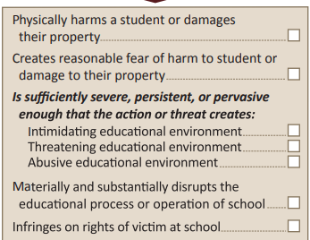

Slide 8
Notice of Bullying
To a parent or guardian of the alleged victim on or before the third business day after the date the incident is reported (the specification of three business days being new); and
• A parent or guardian of the alleged bully within a reasonable amount of time after the incident (as under pre-existing law).
Student Reporting
https://anonymousalerts.com/elpasoisd/

Slide 9
Anonymous Reporting
https://anonymousalerts.com/elpasoisd/

Slide 11
Consequences
Class B - Misdemeanor
Class A – Misdemeanor (Repeat)
Up to 6 months in jail
$2,000 fine
Intent to have victim commit suicide
Violate Restraining Order
Up to 1 year in jail
$4,000 fine

Slide 13
What’s next?
Sometimes how you react can stop the bullying.
Remember... 1. Stay calm, don’t become a “MESS.”
• Mad • Embarrassed • Sad • Scared
What can you do?

Slide 14
September Core Essential
Grit / Fuerza de Voluntad
"Refusing to give up when life gets hard."
"Negarse a rendirse cuando la vida se pone dificil"

Slide 15
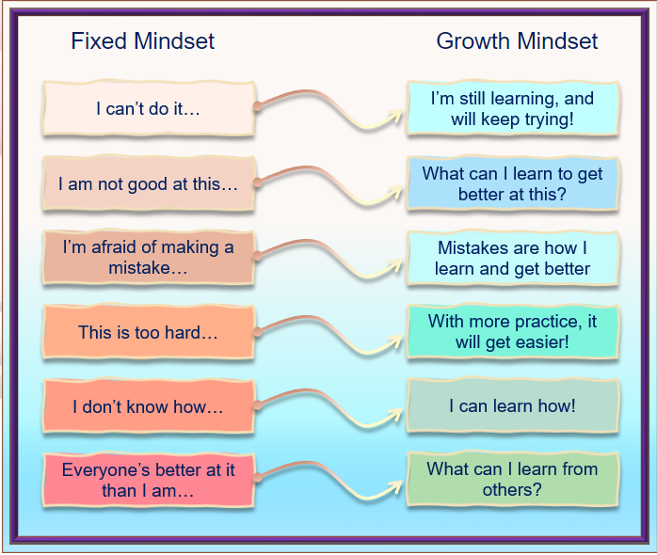
Growth Mindset!
The power of believing you can improve.

